Slide 1

Programming Principles
1811ICT/2807ICT/7001ICT
Week 5 Lecture
Dr Mardé Helbig

Slide 2

control flow statements
Control flows through program statements from top to bottom
Except where control flow statements alter this sequence with selections and loops
Selections: structures where program decides whether to execute some statements or not (if, elif, else)
Loops: structures where programs repeat statements multiple times

Slide 3
Loops
Indefinite loops: do not know how many repetitions are required – will repeat until a specified condition is met (while loop)
Definite loops: know how many repetitions are required (for loop)

Slide 4


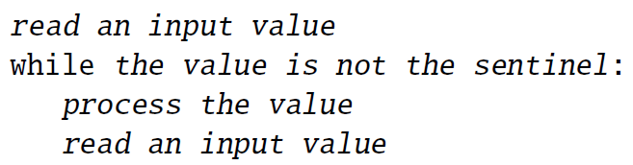


Recap: While loop
You want to determine the average of a student’s marks for their courses completed so far. Prompt the student for their mark until a negative mark is entered. Print out the number of marks entered and the student’s average mark.
# averageGrade.py - calculates the average grade
#sentinel pattern
#read first value
grade = float(input(“Enter a grade (negative value to stop): “))
#check value against condition – not sentinel value
sum = 0
num = 0
while (grade >= 0):
#repeat the following statements
#what do we do with value?
#why here? why not after reading?
sum += grade
num += 1
#read next value
grade = float(input(“Enter a grade (negative value to stop): “))
#print out results (number of grades entered and average)
print(“Number of grades: “, num)
print(“Average grade: “, sum/num)
#Will need:
# - sum of grades entered (only valid grades!)
# - number of valid grades entered
What are some important observations?

Slide 5
Control and Data
Section 13: definite loops with for

Slide 6
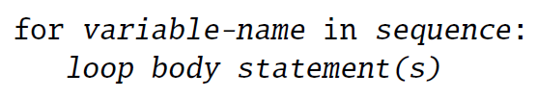
For loop
variable name that will be used to iterate over sequence
Keyword indicating for loop
sequence of values that variable-name will be assigned each time the loop body executes
: separates body statement(s) from sequence
Demo script files
Statements executed repeatedly
Statements are indented!

Slide 7

For loop with strings
Processing a string character by character
>>> python forString.py
h
e
l
l
o
t
h
e
r
e
!
>>>
# forString.py
# print the characters of string vertically
myString = “hello there!”
for ch in myString:
print(ch) #default end=‘\n’

Slide 8
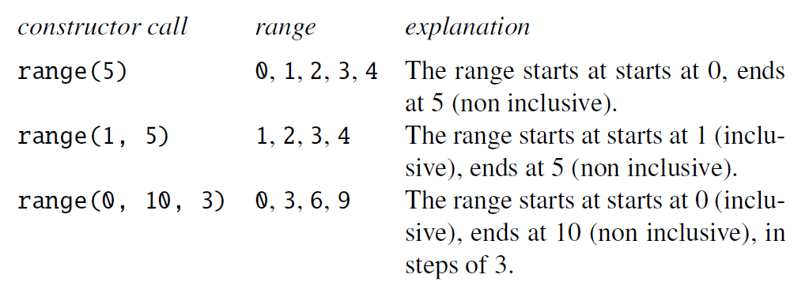
For loop with ranges
An instance of class range is an object that are a sequency of values
# forLoop1.py
# print the numbers 0 to 10 on one line
for i in range(11): #11 is not included
print(i, end=“ “) #we want all numbers on one line
print() #add new line after all numbers are printed
# forLoop2.py
# print the numbers 1 to 10 on one line
for i in range(1, 11): #11 is not included
print(i, end=“ “) #we want all numbers on one line
print() #add new line after all numbers are printed

Slide 9
For loop with ranges
An instance of class range is an object that are a sequency of values
# forLoop3.py
# print the numbers 5 to 25 in steps (increments) of 5 on one line
for i in range(5, 30, 5): #30 is not included
print(i, end=“ “) #we want all numbers on one line
print() #add new line after all numbers are printed
# forLoop4.py
# print the numbers 25 to 5 in steps (decrements) of 5 on one line
#descending order (from high to low) using -5 and not 5
for i in range(25, 0, -5): #0 is not included
print(i, end=“ “) #we want all numbers on one line
print() #add new line after all numbers are printed

Slide 10

for loop – problem solving
Prompt the user for the number of rows and columns, and then print out # accordingly, e.g.
Number of rows: 2
Number of columns: 7
#######
#######
# forLoop5.py
#prompt user for number of rows and columns
rows = int(input(“Number of rows: “))
columns = int(input(“Number of columns: “))
#what will we use here as sequence?
for r in range(1, rows): #why start with 1?
for c in range(1, columns):
#print (r, “ “, c) #printing out the values of r and c
print(“#”)
print() #print a new line after each row
What is happening here with a nested for loop?
Why is it not printing correctly?

Slide 11
For loop – problem solving
Prompt the user for a string. Print out the number of digits in the string.
# forLoop6.py
#prompt user for string
userString = input(“Enter a string: “)
#what will we use here as sequence?
num = 0
for s in userString:
#what will we check for?
if (type(s) == ‘int’):
num += 1
print(“Number of digits in string, “, userString, “ : “, num)
Why is it not working correctly?
Use built-in function: isnumeric()
... isalpha()

Slide 12
for loop – problem solving
You want to determine the average of a student’s grades for their courses completed so far. Prompt the student for their grade until a negative grade is entered. Print out the number of grades entered and the student’s average grade.
How will we change this problem to solve it with a for loop instead of a while loop?
You want to determine the average of a student’s grades for their courses completed so far. Prompt the student for the number of grades they want to enter and then prompt them for those grades. Print out the number of grades entered and the student’s average grade.
What are key differences here? Why?

Slide 13
for loop – problem solving
You want to determine the average of a student’s grades for their courses completed so far. Prompt the student for the number of grades they want to enter and then prompt them for those grades. Print out the number of grades entered and the student’s average grade.
# forLoop7.py
# changing grade example using for loop
#determine how many grades will be entered
gradeNumber = int(input(“How many grades will be entered: “))
total = 0 #sum of the grades
#using the for loop
for range(gradeNumber): #is this correct?
grade = float(input(“Enter a grade: “))
total += grade
print(“Number of grades: “, gradeNumber)
print(“Grade average: “, (total/gradeNumber))
Why is it not working correctly?

Slide 14

Any questions?
Type your question in the Q&A or raise your hand

Slide 15












Temperature Check
How do you feel about for loops?

Slide 16
Control and Data
Section 14: PASS, break, continue

Slide 17

control statements – pass, break, continue
These 3 control statements are used in the bodies of other control statements (such as if, for and while) to change their normal behaviour
But why? And how?

Slide 18
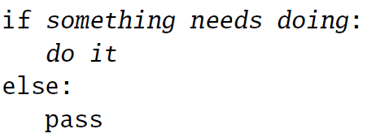
null operation – pass statement
The pass statement does nothing
Used as a placeholder where a statement is required but nothing should be done
For example:
# passStatement.py
# illustrate usage of pass statement
numbers = [0, 1, 2, 3]
for n in numbers:
if (not n):
pass #do nothing if n is 0
else:
n += 2
print(n) #print the result
>>> python passStatement.py
0
3
4
5

Slide 19
Break statement
The break statement terminates the execution of the loop body it occurs in, AND the loop itself
Most useful in for loops that achieve their aim before reaching the end of the sequence
Should be placed inside a selection inside the loop
# breakStatement.py
# illustrate usage of break statement
numbers = [0, 1, 2, 3]
for n in numbers:
if (n == 1): #if (not n): nothing. Why?
break #exits body of loop and loop
else:
n += 2
print(n) #print the result
>>> python breakStatement.py
2

Slide 20
Continue statement
The continue statement terminates the current execution of the loop body it occurs in, but NOT the loop
It skips to the next iteration of the loop
Should be placed inside a selection inside the loop
# continueStatement.py
# illustrate usage of continue statement
numbers = [0, 1, 2, 3]
for n in numbers:
if (not n):
continue #exits body of loop, skips to next iteration
else:
n += 2
print(n) #print the result
>>> python continueStatement.py
3
4
5

Slide 21

Break statement – BAD practice
# averageGrade.py - calculates the average grade
#sentinel pattern
#read first value
grade = float(input(“Enter a grade (negative value to stop): “))
#check value against condition – not sentinel value
sum = 0
num = 0
while (True):
#repeat the following statements
#what do we do with value?
#why here? why not after reading?
if (grade < 0):
break
sum += grade
num += 1
#read next value
grade = float(input(“Enter a grade (negative value to stop): “))
#print out results (number of grades entered and average)
print(“Number of grades: “, num)
print(“Average grade: “, sum/num)
# averageGrade.py - calculates the average grade
#sentinel pattern
#read first value
grade = float(input(“Enter a grade (negative value to stop): “))
#check value against condition – not sentinel value
sum = 0
num = 0
while (grade >= 0):
#repeat the following statements
#what do we do with value?
#why here? why not after reading?
sum += grade
num += 1
#read next value
grade = float(input(“Enter a grade (negative value to stop): “))
#print out results (number of grades entered and average)
print(“Number of grades: “, num)
print(“Average grade: “, sum/num)

Slide 22
Any questions?
Type your question in the Q&A or raise your hand

Slide 23
Temperature Check
How do you feel about pass, break, continue?

